Slide 1


A Study on the Optimization Problem
of Variational AutoEncoder
변이형 오토인코더의 최적화 문제 연구
$${\text{Youmin}\text{−}\text{Min} \text{Ko}}^{1},$$
$${\text{Sun}\text{−}\text{Woo} \text{Ko}}^{2}$$
1
Artificial Intelligence Research Center Jeonju University
2
Department of Artificial Intelligence and
Artificial Intelligence Research Center Jeonju University

Slide 2









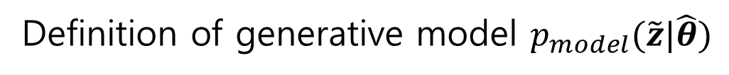








Purpose of generative model
We want to find the population of the data $z∈R^{n_{0}}$,
i.e. the distribution $p(z|θ)$, and generate data from that distribution.
Definition of generative model $p_{model}(\tilde{z}|\hat{θ})$
A model that generates a new data ${\tilde{z}}_{i}$ from $p_{model}\left(\tilde{z} | \hat{θ}\right)$
after estimating the distribution $p_{model}(\tilde{z}|\hat{θ})$ using $Z=(z_{1},…,z_{n})$, which is $n$ data observed from $p(z|θ)$.
$$p(z|θ)$$
$$Z=\left(z_{1},…,z_{n}\right)$$
$$p_{model}\left(\tilde{z} | \hat{θ}\right)$$
$$…$$
Observed $n$ data
$$n_{0}$$
$$…$$
$$…$$

Slide 3





Manifold learning
Manifold hypothesis
The observed data $z_{i}$ is in a low dimensional($R^{n_{c}}$) space(manifold)
that belongs to a high dimensional($R^{n_{0}}$) space.
$$z∈R^{n_{0}}$$
$$(R^{n_{0}}≫R^{n_{c}})$$
$$z^{c}∈R^{n_{c}}$$
$$z_{i}$$

Slide 4
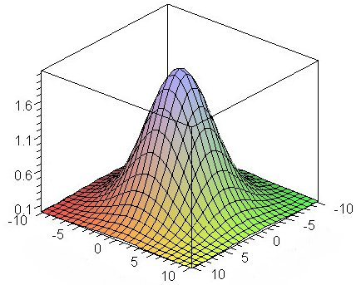
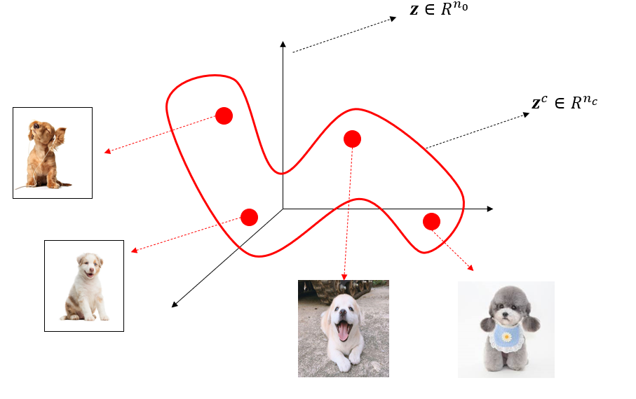







Variational AutoEncoder
$$f_{e}:encoder$$
$$z^{c}∈R^{n_{c}}$$
$$f_{d}:decoder$$
$$\tilde{z}∈R^{n_{0}}$$
$$z∈R^{n_{0}}$$
$$p\left(z^{c}|z\right)$$
$$q\left(z^{c}\right)$$

Slide 5
















General objective function of Variational AutoEncoder : ELBO
$$q\left(z^{c}\right)$$
$$q\left(z^{c}\right)$$
$$q\left(z^{c}\right)$$
$$p\left(z^{c}|z\right)$$
$$p\left(z^{c}|z\right)$$
$$p\left(z^{c}|z\right)$$
Variational inference
$$\min{D_{KL}\left[q\left(z^{c}\right)||p(z^{c}|z)\right]}$$
$$=\min{−E_{\sim q\left(z^{c}\right)}\left[\log{p\left(z | z^{c}\right)}\right]+D_{KL}\left[q\left(z^{c}\right)||p(z^{c})\right]+\log{p(z)}}$$
$$\log{p(z)}≥0$$
$$ELBO(Evidence Lower BOund)$$
Evidence(constant)
ELBO
ELBO used in actual calculations
$$\min{−E_{\sim q\left(z^{c}\right)}\left[\log{p\left(z | z^{c}\right)}\right]+D_{KL}\left[q\left(z^{c}\right)||p(z^{c})\right]}$$
$$\min{\frac{1}{n}}{\left\|Z−\tilde{Z}\right\|}_{F}^{2}+D_{KL}[N\left(\hat{u},\hat{σ}\right)||N\left(0,I\right)]$$
$$Reconstruction error$$
$$KL divergence error$$
$$Reconstruction error$$
$$KL divergence error$$
$$Assumption :$$
$$p\left(z^{c}\right)\sim N(0,I)$$
$$q\left(z^{c}\right)\sim N(\hat{u},\hat{σ})$$
$$Assume that there are n samples\left(Z\right)observed from p(z|z^{c})$$

Slide 6



Definition of Optimization Problem of Variational AutoEncoder
based on generative purpose
1. First, the objective function has to create $\tilde{z}$ that best produces
the observable random variable $z$ we are interested in.(Risk minimization $E[L\left(z,\tilde{z}\right)]$ )
2. Create $\tilde{z}$ using AutoEncoder($f_{e}, f_{d}$) as the first constraint.
3. As a second constraint, $D_{KL}[q(z^{c})|\left|p\left(z^{c} | z\right)\right]$ must be less than some constant $δ$ to learn
a tractable latent distribution($q(z^{c})$).
Primal problem
$$\min{E[L\left(z,\tilde{z}\right)]}$$
$$s.t. \tilde{z}=f_{d}(f_{e}\left(z\right))$$
$$D_{KL}[q(z^{c})|\left|p\left(z^{c} | z\right)\right]≤δ$$

Slide 7





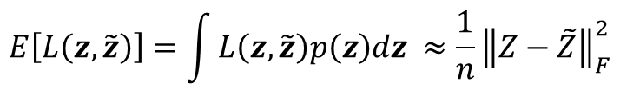




Derivation of Objective Function in Actual Calculation
Primal problem
$$E\left[L\left(z,\tilde{z}\right)\right]=\int{L\left(z,\tilde{z}\right)p\left(z\right)dz }≈\frac{1}{n}{\left\|Z−\tilde{Z}\right\|}_{F}^{2}$$
1
$$\min{E[L\left(z,\tilde{z}\right)]}$$
1
- Do not know $p\left(z\right)→$ Use Monte Carlo Method
$$s.t. \tilde{z}=f_{d}(f_{e}\left(z\right))$$
- If we use $L$ as $l2−norm$
$$D_{KL}[q(z^{c})|\left|p\left(z^{c} | z\right)\right]≤δ$$
2
2
$$D_{KL}\left[N\left(\hat{u},\hat{σ}\right)||N(0,I)\right]+\frac{1}{n}{\left\|Z−\tilde{Z}\right\|}_{F}^{2}≤δ$$
- Using ELBO(kingma and Welling) expressions
Lagrangian primal problem
$$\min\left(1+α\right)\frac{1}{n}{\left\|Z−\tilde{Z}\right\|}_{F}^{2}+α(D_{KL}\left[N\left(\hat{u},\hat{σ}\right)||N(0,I)\right]−δ)$$
$$\min{\frac{1}{n}{\left\|Z−\tilde{Z}\right\|}_{F}^{2}}$$
$$s.t. α≥0$$
$$s.t. \tilde{z}=f_{d}(f_{e}\left(z\right))$$
$$D_{KL}\left[N\left(\hat{u},\hat{σ}\right)||N(0,I)\right]+\frac{1}{n}{\left\|Z−\tilde{Z}\right\|}_{F}^{2}≤δ$$
Lagrangian multiplier method

Slide 8


Comparison
Lagrangian primal problem
$$\min\left(1+α\right)\frac{1}{n}{\left\|Z−\tilde{Z}\right\|}_{F}^{2}+α(D_{KL}\left[N\left(\hat{u},\hat{σ}\right)||N(0,I)\right]−δ)$$
$$s.t. α≥0$$
ELBO
$$\min{\frac{1}{n}}{\left\|Z−\tilde{Z}\right\|}_{F}^{2}+D_{KL}[N\left(\hat{u},\hat{σ}\right)||N\left(0,I\right)]$$

Slide 9
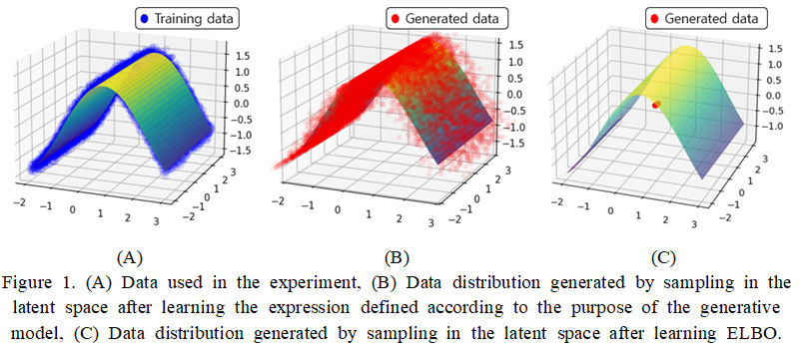
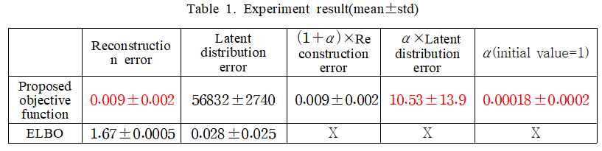
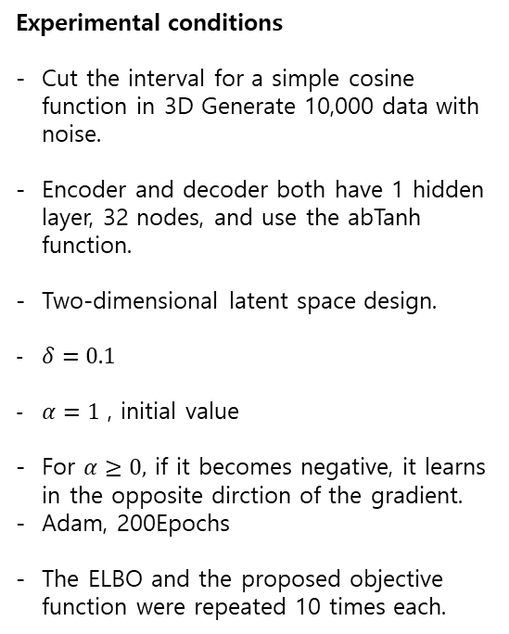
Experiment
Experimental conditions
Cut the interval for a simple cosine function in 3D Generate 10,000 data with noise.
Encoder and decoder both have 1 hidden layer, 32 nodes, and use the abTanh function.
Two-dimensional latent space design.
$δ=0.1$
$α=1$ , initial value
For $α≥0,$ if it becomes negative, it learns in the opposite dirction of the gradient.
Adam, 200Epochs
The ELBO and the proposed objective function were repeated 10 times each.

